Slide 1

SENCo Forum Training
Dr Scott Ighavongbe-Patrick

Slide 2
What will we cover?
Challenging behaviour
Managing social, emotional and mental health challenges in pupils
The function of presenting behaviours and the needs of the pupil
An introduction to Affect Script Theory
Strategies to support pupils, individually and systemically

Slide 3
Understanding challenging behaviour
Challenging behaviour can be defined as any behaviour that interferes with a pupil's learning or the learning of others.
It can include things like aggression, defiance, withdrawal, and self-injury.
It is important to recognise that challenging behaviour can be a manifestation of underlying social, emotional, and mental health challenges.
As educators, it's our responsibility to understand the function of presenting behaviours, so we can identify the needs of the pupils who are exhibiting them.

Slide 4
The function of presenting behaviours and assessment tools
Presenting behaviours may not always conform to school norms, but they may serve to minimise negative affects triggered by persistent challenges.
Educators can use several tools and resources to assess the function of presenting behaviours. These resources can help to identify the underlying needs of pupils and inform the development of targeted support strategies, examples include:
Functional behaviour assessments.
Observations, interviews, and checklists.

Slide 5
Affect Script Theory
Silvan Tomkins- 9 innate affects hard-wired into our autonomic nervous system from birth.
We have no control over these and they are triggered by stimulus in our environment and/or thoughts.
Central Executive
Maximise positive affect
Minimise negative affect
Minimise the inhibition of affect

Slide 6
Positive affects
Interests- Excitement
Enjoyment-Joy
Neutral affects
Surprise- Startle
Negative affects
Distress-Anguish
Dismell
Fear-Terror
Anger-Rage
Shame-Humiliation
Disgust
Notes:
Examples of what might trigger these affects include:
Pupil’s senses picking up something to big, too loud, or too fast, and/or feeling threatened (fear-terror).
Response triggered when too much has been happening for too long, or when overwhelmed (distress-anguish).
When that too much finally stops happening or a reward is received (enjoyment-joy).
When senses encounter a novel stimulus that is just right or discovering something new (interest-excitement).
Experiencing an unexpected event (surprise-startle).
Being treated unfairly (anger-rage).
Encountering something unpleasant (disgust).
Feeling exposed (shame-humiliation).
Select one or two examples- don’t go through them all
A pupil's biography can intensify their reactions to situations. This is particularly true when pupils are confronted with challenges that have persisted for a long time.
Pupils may use presenting behaviours as a way to maximise positive affects and avoid negative affects triggered by persistent challenges. For example, a pupil who has experienced neglect may seek attention through disruptive behaviour, as a way of compensating for the lack of attention they received at home.
By understanding the role of biography, we can begin to recognise the underlying needs of pupils and respond to them in a more targeted way.
Most of the experiences of interest and joy that get impeded have to do with interpersonal engagement with others. So, think of shame as an interpersonal/interactional affect.
Once positive affect is impeded, the affect shame focuses attention on the impediment that triggered the negative affect.
Now, the thing is what we see in the moment of shame is something in us that isn’t perfect – scripted emotions/biography.
Pupil’s draw on scripts built up over time to help minimise the destructive impact of negative affects…

Slide 7
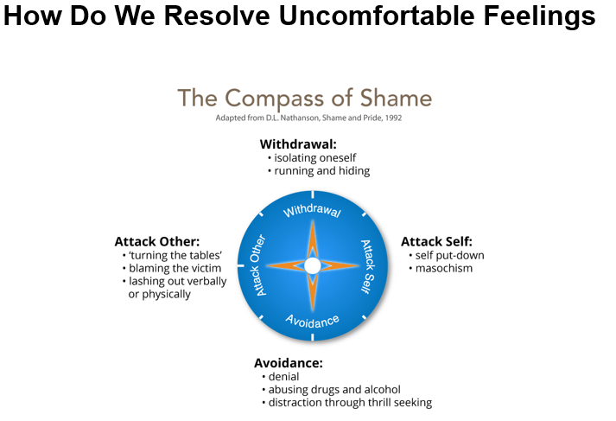
The compass of shame poles and scripts
Notes:
The four poles of the compass of shame are:
Withdrawal (the pupil retreats into themselves, switch off from learning and not attend lessons).
Avoidance (the pupil avoids the situation altogether, be the class clown, focus on other aspect of their lives, take risks, use drugs etc.).
Attack others (the pupil blames others, put others down, belittle value of work, diminish and bully others etc.).
Attack self (the pupil blames themselves, put themselves down, they assume they are dumb etc.).
When pupils feel shame, they may draw on these scripts as a way of protecting themselves from further harm.
As educators, it's important to recognise the power imbalances that exist between staff and pupils and work to create a safe and trusting environment where pupils feel comfortable expressing their underlying struggles.

Slide 8
Supporting pupils and practical advice
There are many strategies for supporting pupils with social, emotional, and mental health challenges.
Individually, strategies such as counselling, mentoring and pastoral care can be effective in helping pupils to identify and manage their presenting behaviours.
As a whole school, approaches such as positive behaviour support and restorative justice can be effective in creating a safe and supportive environment for pupils.
Notes:
In addition to these strategies, educators can use the following practical tips to manage challenging behaviours:
Set clear expectations and boundaries for behaviour.
Use positive reinforcement to encourage positive behaviours.
Be consistent in your responses to behaviours.
Use visual aids and other non-verbal communication tools to support pupils with communication difficulties.
Use de-escalation techniques to manage situations where pupils are becoming agitated or upset.
Work collaboratively with other professionals, such as counsellors and therapists, to provide comprehensive support to pupils.
Provide opportunities for pupils to express their feelings and concerns in a safe and supportive environment.
Create a risk-tolerant learning zone.
Establish/communicate high expectations (not just high standards).
Example of communicating high expectations: As you learn this, mistakes are expected. Your mistakes help me to support you. Let’s make mistakes together!
Give feedback that focuses on process – things that they can control.
Example of when they struggle despite strong effort: I admire your persistence and I appreciate your hard work. It will pay off!
Example of when they struggle and needs help with strategies: Let’s do one together…
Example of when they are making progress: I see you using your strategies/tools/notes etc. keep it up!
Example of when they succeed with strong effort: I am very proud of you for not giving up and look what you have to show for it!
Focus on how tasks/activities are framed and how feedback is provided
Example of communicating learning goals: we are in the learning zone today; mistakes are our friends!

Slide 9
Things to take away
Managing challenging behaviour requires us to consider the function of presenting behaviours and the needs of pupils who are exhibiting them.
By understanding the theory of affect script, the role of biography, and the compass of shame, we can begin to recognise the underlying needs of pupils and respond to them in a more targeted way.
Using assessment tools and resources, educators can identify the underlying needs of pupils and develop targeted support strategies.
Through using practical tips, educators can manage challenging behaviours and support pupils to achieve positive outcomes.

